Slide 1
An Examination

Slide 2
The Five Tenets of the Mega Church:
Enlargement
Ecumenicalism
Emotionalism
Entertainment
Empathy
Michal Hardin, “The Blueprint for Mega-churches.” The Bible And Contemporary Churches, edited by Mike Willis. Guardian of Truth Foundation, 2005, pp. 60-63.

Slide 3
“In reaction to the pitfalls of denominations, the mid-20th century birthed the baby boomer phenomenon of the “nondenominational megachurch.” American evangelicalism saw a rising tide of churches that were explicitly or implicitly anti-doctrinal and nontraditional, focused on relevance, extraversion, positivity, attractional style and seeker-sensitivity. Often these churches are helmed by a charismatic male head-pastor.”
Warner, Tish, “Willow Creek’s Crash Show Why Denominations Still Matter,” www.religionnews.com/2019/03/25/willow-creeks-crash-shows-why-denominations-still-matter/

Slide 4
Question:
Is it wrong for the Lord’s body to own and maintain a church building?
AUTHORITY
Specific?
singing spiritual songs
giving first day of the week
preaching the word
assembling with the saints
Generic?
?
?

Slide 5
The MAJOR FACTORS For Adults Who Attend A Church Monthly or More:
John 6:26, “Jesus answered them and said, ‘Most assuredly, I say to you, you seek Me, not because you saw the signs, but because you ate of the loaves and were filled.’ ”
Sermons or talks that teach you more about scripture
Sermons or lectures that help you connect religion to your own life
Spiritual programs geared toward children and teenagers
Lots of community outreach and volunteer opportunities
Dynamic religious leaders who are interesting and inspiring
Social activities that allow you to get to know people in your community
A good choir, praise band, cantors or other spiritual music
76%
75%
64%
59%
54%
49%
38%
Source: https://news.gallup.com/poll/1690/religion.aspx, accessed, April 25, 2019.

Slide 6
Positively No Authority From God’s Word
use of passages like Luke 14:15-24 to justify church-sponsored feasts
Ignores context (14:16)
ignores previous context (14:7ff)
ignores who is to be invited:
DO NOT INVITE friends, brothers, relatives, rich neighbors, lest they repay (14:12)
DO INVITE those who cannot pay, the poor, maimed, lame, blind (14:13, 14, 21, 23)

Slide 7
Positively No Authority From God’s Word
use of passages like Luke 14:15-24 to justify church-sponsored feasts
ignores the spiritual connotation (14:11, 15)
the kingdom’s bread is not physical bread but the word of life (Lk. 4:4; Jn. 6:27, 63)
Why choose literal food in Luke 14 and not a literal dress code in Matthew 22:1-14?

Slide 8
Romans 14:17
“For the kingdom of God is not eating and drinking, but righteousness and peace and joy in the Holy Spirit”

Slide 9
Preaching—God’s Mode And Choice For Attracting Sinners
attracts those who are being saved (1 Cor. 1:18)
the cross can be made of no effect when we misplace the emphasis
“wisdom of words” (1 Cor. 1:17)
“human wisdom” (1 Cor. 2:4)
“wisdom of this age” (1 Cor. 2:6)
“man’s wisdom” (1 Cor. 2:13)

Slide 10
Worldly Attractions Often Appeal To Something “Different”
Where Is The Lord Magnified on this Advertisement?

Slide 11
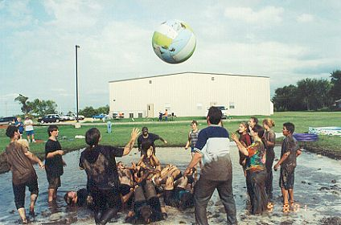
Where Will The Frolic End?
“Then they rose early on the next day, offered burnt offerings, and brought peace offerings, and the people sat down to eat and drink, and rose up to play” (Ex. 32:6)
Metroplex Fellowship Church of the Nazarene, Oklahoma City

Slide 12
Where Will The Frolic End?
“And when he came near the tents he saw the image of the ox, and the people dancing; and in his wrath Moses let the stones go from his hands…And Moses saw that the people were out of control, for Aaron had let them loose to their shame before their haters (Ex. 32:19, 25; BBE)
Metroplex Fellowship Church of the Nazarene, Oklahoma City

Slide 13
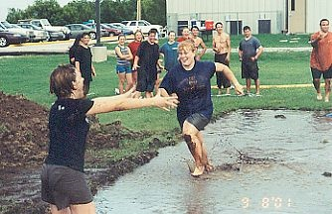
Where Will The Frolic End?
“In like manner also, that the women adorn themselves in modest apparel, with propriety and moderation…which is proper for women professing godliness, with good works” (1 Tim. 2:9, 10)
Metroplex Fellowship Church of the Nazarene, Oklahoma City

Slide 14
What They Draw
“To draw people, they use an inviting, informal approach, with well-produced dramatic shows, sermons relevant to their congregants' lives, and catchy jazz and pop music. When it was founded in the early 1970s, Willow Creek set out explicitly to research what people did and didn't like about going to church, and tailored their services accordingly. The low-pressure atmosphere of Mariners Church helped convince Lorraine Hanson to join, she says. ‘In some ways you can maintain a sense of anonymity if you want to,’ she says. ‘It's very non-threatening.’”
(Libaw, abcnews.com)

Slide 15
Christ Doesn’t Draw Us To ANONYMITY, but ACTIVITY
“From whom the whole body, joined and knit together by what every joint supplies, according to the effective working by which every part does its share, causes growth of the body for the edifying of itself in love.”
(Ephesians 4:16; cf. Phil. 2:14-16)

Slide 16
“Non-threatening”
“Don’t hit them over the head with everything they’re doing wrong. A lot of their sins will be dealt with after they come to Christ.”
(Rick Warren, Purpose Driven Church, p. 216)
Isn’t the purpose for coming to Christ to deal with sin?
Is “repentance” threatening?
Is “repentance” an optional component of the gospel message (Luke 13:3; 24:47; Acts 2:38)

Slide 17
Questions:
For WHAT did Christ die? 1 Corinthians 15:3
WHAT is sin? 1 John 3:2
How can we be attracted to Christ’s death without having regard for “LAW”?
How can we apply the death of Christ without dealing with our sins?

Slide 18
“NON-THREATENING SERVICES”
Would Rick Warren approve of:
Paul’s preaching (Col. 1:28; 1 Cor. 4:21)
Stephen’s preaching (Acts 7:51, 52)
Peter’s preaching (Acts 2:23; 8:20-23)
Jesus’ preaching (Lk. 4:18-30)
did Jesus fail to teach His audience “anger management”?

Slide 19
“impact” more important than “information”
“storytelling” over “instruction”
“Stories stir our emotions. They impact us in ways that precepts and propositions never do. If you want to change lives, you must craft your message for impact, not information” (Rick Warren)
“I believe it is a sin to bore people with the Bible” (Rick Warren)
criticizes preachers who say, “We are not here to entertain.”

Slide 20
There is a Place For IMPACT!
Eze 6:11, “Thus says the Lord GOD: ‘Pound your fists and stamp your feet, and say, ‘Alas, for all the evil abominations of the house of Israel! For they shall fall by the sword, by famine, and by pestilence.
IMPACT WITH INFORMATION!

Slide 21
Did Paul Sin?
“…Paul…continued his message until midnight…And in a window sat a certain young man named Eutychus, who was sinking into a deep sleep. He was overcome by sleep; and as Paul continued speaking, he fell down from the third story and was taken up dead” (Acts 20:7, 9)
Did Paul use too much “info” and not enough impact?
Whose preaching saved more souls, Paul’s or Rick Warren’s?

Slide 22
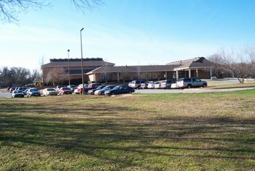
“IMPACT” Void of “INFORMATION”
We don't care about religion! There...got your attention. What we do care about is relationships - your relationship with God and others, including family, friends and work colleagues. Jesus said that's what being a Christian is all about - God first, others second. Keep that simple principle in mind, and you can cover all Ten Commandments.
Arlington, TX

Slide 23
“INFORMATION” or “NONSENSE”?
We believe that the Bible is the inspired Word of God - if it's not in there, then we don't place much weight on it. We try and make everything we do conform to the Bible.
Arlington, TX
BUT ON THE SAME PAGE. . .
We believe that all that's needed to get a pre-paid ticket to heaven and have the power of God in you is to pray a prayer…
WHERE DOES THE BIBLE TEACH IT?

Slide 24
“INFORMATION” or “NONSENSE”?
We believe that the Bible is the inspired Word of God - if it's not in there, then we don't place much weight on it. We try and make everything we do conform to the Bible.
Arlington, TX
WHERE IS THAT
PASSAGE?
We invite you to visit us at our 31-acre facility! There's something for the whole family, at one location. 60,000 sq. ft. facility - Athletic Fields - Tennis Court - Gymnasium - Swimming Pool - Fishing Pond

Slide 25
“JESUS PLUS NOTHING. WE'RE ALL ABOUT RELATIONSHIP WITH JESUS CHRIST, NOT LEGALISTIC, RELIGIOUS RULES.”

Slide 26
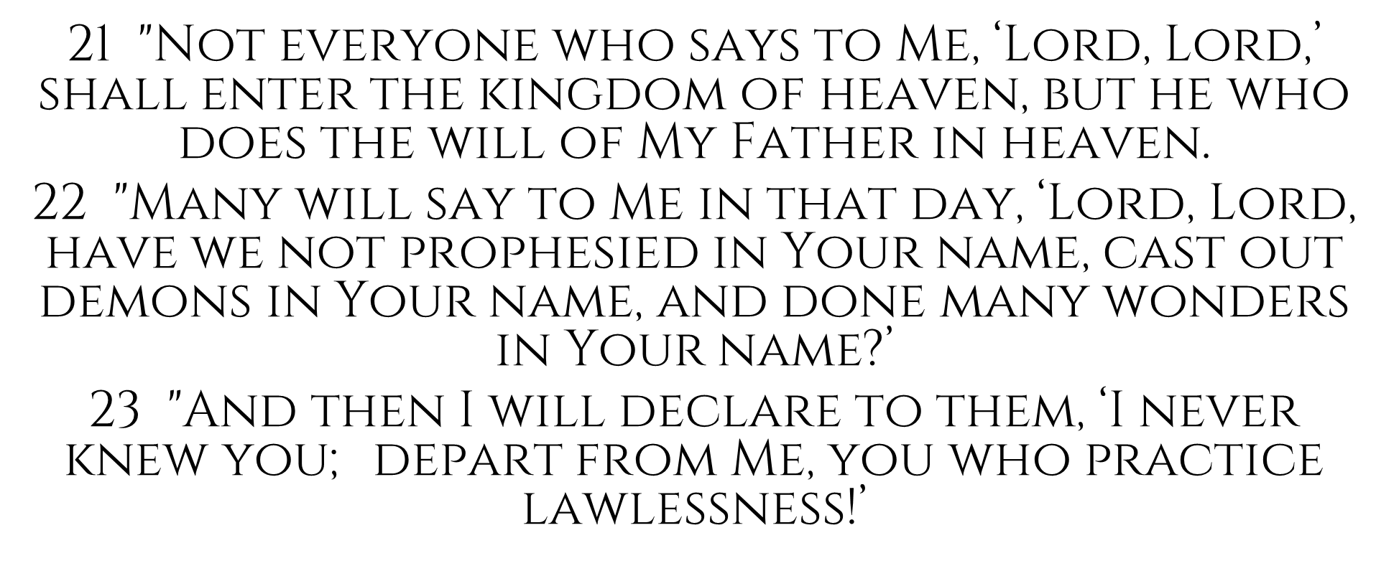
Matthew 7

Slide 27
What Effect On
Churches of Christ

Slide 28
Lordship & Discipleship?
San Diego Church of Christ
“As disciples of Jesus, we surrender our lives to his Lordship. We rejoice in our adoption as God’s children, and each accepts the call to be holy and follow the example of Jesus.”
www.sdcoc.org/what-we-believe, accessed April 25, 2019

Slide 29
San Diego Church of Christ
“…we surrender our lives to his Lordship…and follow the example of Jesus”
"Moonlight Masquerade" Teen Prom, 2003
We are excited to announce the first annual Teen Prom! This year's theme is "Moonlight Masquerade". Each person/couple is responsible for designing their own mask. The evening should be a night to remember! We will have a full, sit-down dinner, pictures, dancing, the whole works! Time: 6:30p-11:00p Place: Hyatt Islandia, Mission Bay Date: Saturday, February 15th Cost: $35/person (dinner included!) - pay at the door
www.SDCOC.com

Slide 30
San Diego Church of Christ
“…we surrender our lives to his Lordship…and follow the example of Jesus”
PRETEEN CAMP, 2003!! Lookie...here is a sneak preview of Preteen Camp, 2003... Our theme for Preteen Camp has been entitled "No Rules"...that's right..."No Rules"...can you believe it! We will be learning alot [sic] about how our relationship with God is not about rules and regulations, but about loving Jesus from our hearts and how much He really loves us. We will learn about "Who Really Rules in Our Lives" and how "God's Rules" lead us to make wise choices that will make our lives happy!!
San Diego Church of Christ

Slide 31
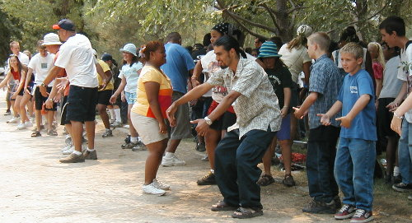
San Diego Church of Christ
“…we surrender our lives to his Lordship…and follow the example of Jesus”
PRETEEN CAMP, 2003!! We will be having our 'Formal Dinner', tons of Mud Wrestling, our Princess Party and so much more! This year our camp will be at Idllywild Pines...and ya know what...they have a HUGE POOL! We may even be able to do some Horse Back Riding on the camp grounds as well. Get ready for some Mountain Climbing! Let's also begin praying about the great spiritual messages and discipleship groups that will be happening throughout each day at camp...

Slide 32
2 TIMOTHY 3:2-5
² For men will be lovers of themselves, lovers of money, boasters, proud, blasphemers, disobedient to parents, unthankful, unholy, ³ unloving, unforgiving, slanderers, without self-control, brutal, despisers of good, ⁴ traitors, headstrong, haughty, lovers of pleasure rather than lovers of God, ⁵ having a form of godliness but denying its power. And from such people turn away!

Slide 33
Effects on Conservative Churches?
VBS geared toward “fun” instead of “Bible instruction”
gimmicks added to the gospel
food is served
plays worked on and acted out for audience
emphasis shift from gospel to numerical growth

Slide 34
Other Signs:
advertising secular events (camping, games, potlucks, etc.) with spiritual
churches changing names to be more ambiguous (e.g., Canyon Church)
tolerant attitude toward those in error; intolerant toward those who expose error

Slide 35
Other Signs:
changes in preaching
non controversial messages
less militant, emphasize the positive; eliminate the negative
do not identify names of false teachers or denominations
emphasis on personal stories over Scripture
no or little applications of Scripture
sermonettes
sugar-toned sermons

Slide 36
The Mega Church
is appealing to the worldly-minded person
is growing
is influential
IS DANGEROUS
gives lip service to truth
emphasis is on the natural man
baits with entertainment
has no regard for the authority of the Scriptures

Slide 37
Isaiah 8:20
“To the law and to the testimony! If they do not speak according to this word, it is because there is no light in them”
God’s word is our guide
God’s word shows who is of light and who is darkness

Slide 38
A Religion like Jeroboam (1 Kin. 12:25-33)
Jeroboam sold his religion by appealing to “convenience” rather than the law of Moses (v. 28)
CGM appeals to programs, entertainment, catchy phrases, etc. to sell their religion rather than the N.T.

Slide 39
SIMILARITY TO Jeremiah 5:30, 31
“An astonishing and horrible thing has been committed in the land; the prophets prophesy falsely, and the priests rule by their own power; and My people love to have it so. But what will you do in the end?”

Slide 40
Simply Put. . .
“They are of the world. Therefore they speak as of the world, and the world hears them. We are of God. He who knows God hears us; he who is not of God does not hear us. By this we know the spirit of truth and the spirit of error” (1 Jn. 4:5, 6)

Slide 41
True Growth
doesn’t come from some larger church feeding off of smaller or dying churches
doesn’t come from sowing a watered down version of the gospel
comes when God’s people are at work in the field planting the true seed
“I planted, Apollos watered, but God gave the increase” (1 Cor. 3:6)

Slide 42
Zechariah 4:6
“This is the word of the Lord to Zerubbabel: ‘Not by might nor by power, but by My Spirit,’ says the Lord of hosts.”

